Slide 1
IBM Data Science Professional Certificate
Deming Wang
12/02/2020

Slide 2
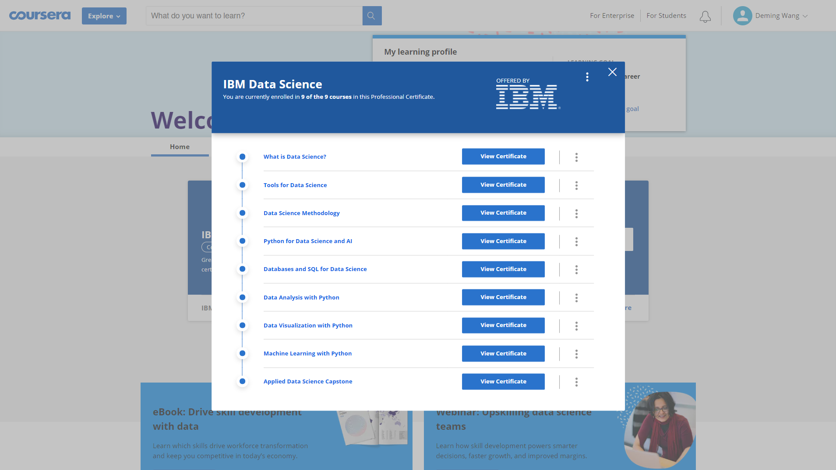

Slide 3
